Slide 1
Introduction to the RAC Wireless Communication Subcommittee
June 21, 2021

Slide 2
CONTENTS
Purpose of subcommittee
Organization
Status of team
Remaining work

Slide 3
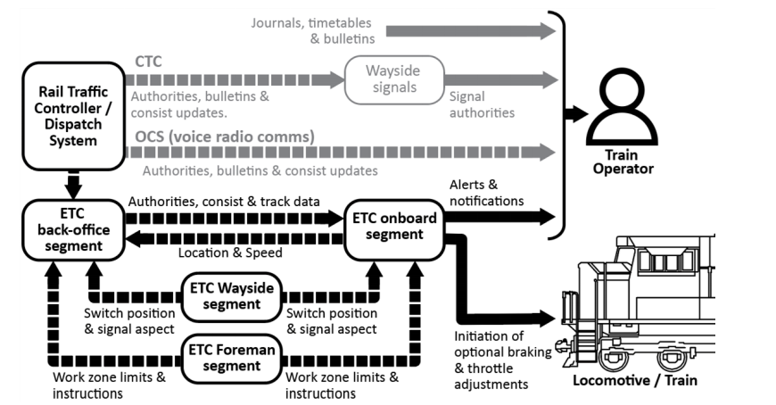
Purpose
Write a report by end of July that gives recommendations to the ETC Lead team on spectrum to use, and requirements recommendations for ETC
ETC lead team will work with Transport Canada to approach ISED about spectrum

Slide 4
ORGANIZATION
7 teams, with an ETC Lead team

Slide 5
RAC Wireless Communications SubCommittee
Consists of RAC, CN, CP, Metrolinx and Via
RAC Wireless Communications Subcommittee (WCS)
Railway | Members | Contacts
CN | Antonio Aranibar | antonio.aranibar@cn.ca
 | Simon Beliveau | simon.beliveau@cn.ca
 | Jorge Groisman | Jorge.Groisman@cn.ca
CP | Trevor Smith | trevor_smith@cpr.ca
 | Glen Swedlo | glen_swedlo@cpr.ca
 | Muhammad Pasha | muhammad_pasha@cpr.ca
 | Manish Pantha | manish_pantha@cpr.ca
 | Norbert Chan | norbert_chan@cpr.ca
 | Kevin Waldern | kevin_waldern@cpr.ca
Mx | Pavel Danshin | Pavel.Danshin@metrolinx.com
 | Rey Badua | Rey.Badua@metrolinx.com
VIA | Frederick Chevrier | frederick_chevrier@viarail.ca
RAC | Enzo De Benetti | edebenetti@railcan.ca

Slide 6
Progress of Work
Enzo De Benetti, “ETC Technology Options”, March 2021
Evaluation criteria to compare 160 MHz, 220 MHz, 900 MHz and shared LTE (600 MHz)

Slide 7
Progress of WORK
Started off meeting once every 2 weeks, now meet once a week
All railroads have provided rankings for the four bands
 |  |  |  |  |  |  | 160 MHz
 |  |  |  |  |  | Weight | CN | CP | Metrolinx | VIA | Composite
Non RFI Criteria
 |  | Spectrum |  |  |  | 1.00 | 6 | 8 | 5.5 |  | 6.50
 |  | Risk (low value means "riskier" - high value means "lesser risk") |  |  |  | 1.00 | 3 | 1 | 3 |  | 2.3333
 |  | Complexity of deployment (low value means "more complexity" - high value means "less complexity") |  |  |  | 1.00 | 3 | 2 | 3 |  | 2.6667
 |  | Future Proof |  |  |  | 1.00 | 6 | 7.6 | 6 |  | 6.5333
 |  | Industry support |  |  |  | 1.00 | 4 | 3 | 4 |  | 3.6667
 |  | Meets requirements |  |  |  | 1.00 | 7 | 10 | 7 |  | 8
 |  | Suitability in railroad environment (AREMA) |  |  |  | 1.00 | 6 | 8.8 | 5 |  | 6.6
 |  | Re-use of infrastructure vs new investment |  |  |  | 1.00 | 8 | 6 | 5 |  | 6.3333
 |  | Security |  |  |  | 1.00 | 7 | 8.8 | 7 |  | 7.6
 |  | Versatility |  |  |  | 1.00 | 7 | 7 | 7 |  | 7
 |  | Financial Constraints (low value means "more expensive" - high value means "less expensive") |  |  |  | 1.00 | 5 | 4.2 | 5 |  | 4.7333
 |  | Interoperability |  |  |  | 1.00 | 5 | 8.6 | 5 |  | 6.2
 |  | Open standard |  |  |  | 1.00 | 7 | 7.2 | 7 |  | 7.0667

Slide 8
Next STEPS
Discuss using commercial satellite
Discuss the weightings of the criteria
Write final report for July

Slide 9
CHALLENGES
Formal requirements for ETC not defined, so rely on AAR requirements for PTC in US
The architecture is still being defined, with many possibilities to consider, such as, do locomotives communicate with each other without going through the back office, are there wayside radios, is ETC only going to work in the urban areas, and will there be a back office.

