Slide 1
Railway Association of Canada
IEEE 802.16 – Ondas Update
June 2020

Slide 2
Agenda
Introduction to Ondas
IEEE 802.16 Review w/focus on key features
Ondas Rail Initiatives
Discussion & Questions

Slide 3
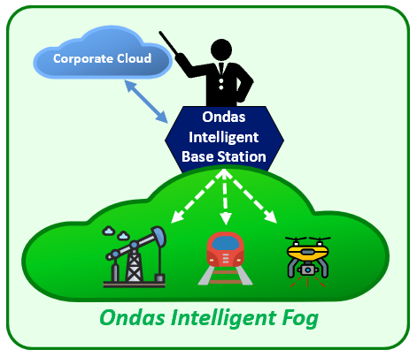






Ondas Overview
Snapshot
Business Highlights
Next-gen, MC-IoT Industrial wireless broadband platform
Massive private network upgrade cycle in critical infrastructure
  Railroads, Utilities, Public Safety, Oil & Gas, Drones
  Fog-compute & intelligent sensor-based solutions at network edge
Blue chip customers and ecosystem partners
  Multiple Class 1 Rail networks (including 900 MHz) targeted
  Nationwide, UAS command & control network (AURA Network Systems)
FullMAX Software platform forms core of IEEE wireless standards
Attractive, capital-light economic model
Founded: 2006
Ticker: ONDS (Nasdaq)
Headquarters: Sunnyvale, CA
Patents: 14 patents (6 issued in the U.S., 7 pending in the U.S., 1 pending internationally)
Industrial IoT Standards: 802.16s; 802.16t (pending)
Ecosystem Partners / Customers

Slide 4
802.16-2017 Review
IEEE 802.16s published in October 2017 and included into IEEE 802.16-2017 Standard
Developed SPECIFICALLY to serve mission critical industries and NOT the consumer market
IP based radio acting as an IP layer 2 bridge
IEEE 802.16s is a TDD Air Interface Protocol, allowing for both asymmetrical or reverse asymmetrical operation for more efficient use of bandwidth
Designed for channel sizes mission critical industries have access to (100 kHz up to 1.25 MHz)
Adapts the standard waveform bandwidth to the narrower channels by…
  Reducing the number of sub-channels
  Reducing the number of subcarriers to avoid minimizing subcarrier spacing
Use of adjacent subcarrier per sub-channel allocation scheme known as “Band AMC”
  Band AMC 2x3, Band AMC 1x6, Band AMC 1x3

Slide 5
802.16t Update
Project formally authorized February 2020. Active participants include:
  Industry: Drones, Public Utilities (electric & water), Oil & Gas
  Rail: BNSF, UP, Meteorcomm, Siemens
Project Authorization Request (PAR) revised in July 2020 to include:
  Licensed spectrum operation with channel bandwidths as small as 5 kHz
  Will specify a new PHY, and changes to the MAC as necessary to support the PHY
  Frequency independent but focuses on spectrum less than 2 GHz.
  The range and data rate supported by the narrower channels are commensurate with those of the base standard, as scaled by the reduced channel bandwidth.
  Support aggregated operation in adjacent and non-adjacent channels.

Slide 6
802.16t Recent Activity
Use Cases from multiple industries. Rail use cases from MeteorComm & Siemens include:
  CTC, Differential GPS, Employee-In-Charge, EOT/HOT, Defect Detector, Hi-Rail Limits, Distributed Power, I-ETMS, Remote Control Loco, Wayside Maint, Wayside Signaling, Crossing Monitoring
System Requirements Document approved March 2021:
  Duplexing and Frame Configurations
  Mobility
  Data Transport - Low, Medium and High throughput Use Cases
  Spectral Efficiency
  Coverage
  Advanced Antenna Systems (e.g. Beam Forming)
  Coexistence with active PLMR channels
  Cyber Security Enhancements

Slide 7
IEEE 802.16s
QOS & Security
Quality of Service (QoS )
  Base Station allocates air interface resources to the Remotes based on QoS profile
  Traffic Prioritization and Scheduling
    Best Effort (BE) Scheduling
    Unsolicited Grant Service (UGS) Scheduling
Security
  Authentication: EAP-TLS process with X.509 certificates between Base & Remote
  Authorization: User management locally by device or by AAA server
  Encryption: Over-the Air encryption is AES 128 or 256
  Key Management: Privacy and Key Management Protocol version 2 (PKMv2)
Security enhancements included in 802.16t requirements

Slide 8
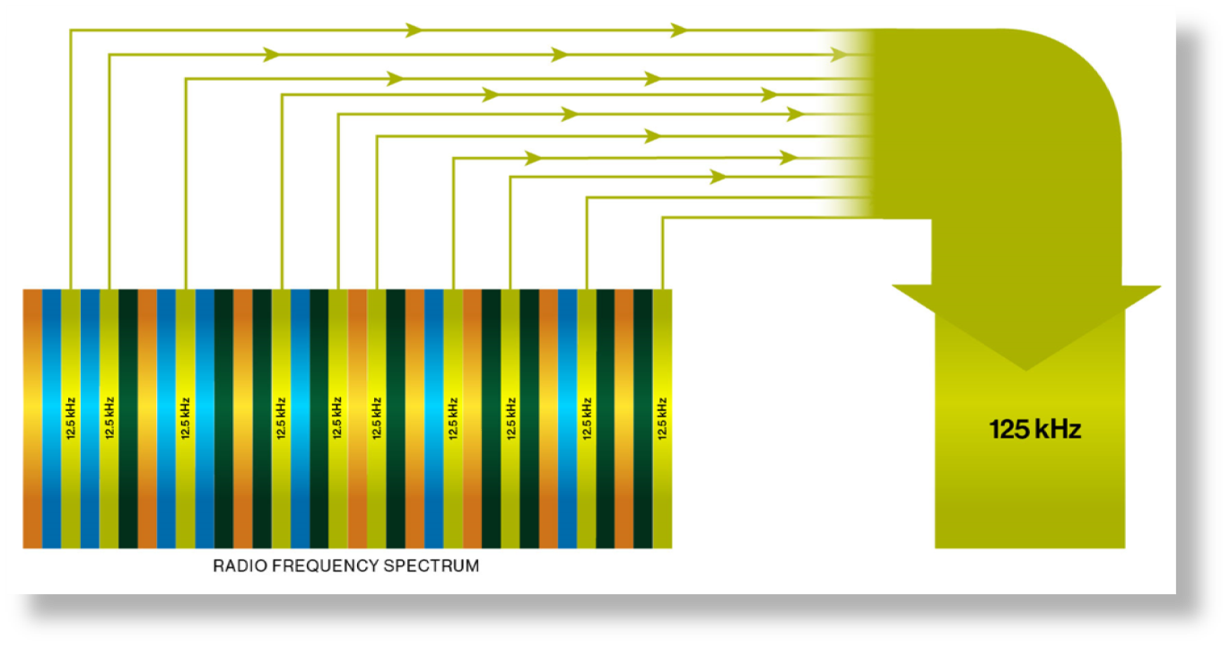
802.16t Proposed
Spectrum Harvesting
Ondas Mc-Iot platform can aggregate non-adjacent channels bringing significant performance and value to our customers scarce spectrum assets.

Slide 9
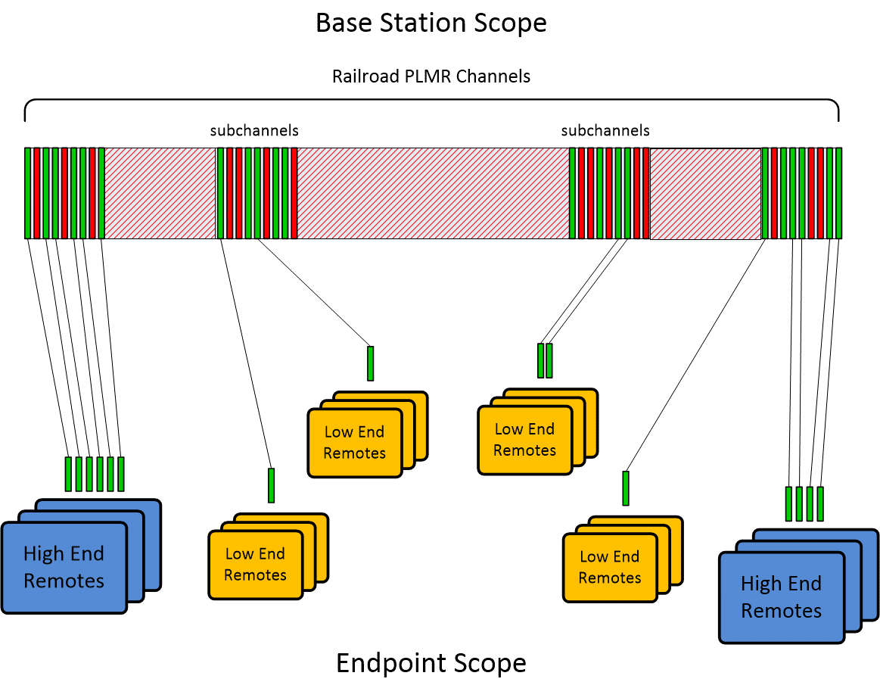
802.16t Channel Aggregation
Enables Next Gen 160 Radio
NextGen 160 Radio: Legacy Voice & Data + Virtual Voice
White: Virtual Voice & Data
Grey: FM Analog Voice & NXDN + Virtual Voice & Data
Black: Never Use
180 - 7.5Khz Subchannels covers AAR 160Mhz

Slide 10
Interoperable 900Mhz General Purpose Network
Interoperable:
  Shared Base Stations
  SD-Wan for IP Backhaul
  ITCM & native IP protocols
QOS:
  Ability to accommodate wayside & mobile apps with varying business priority, bandwidth, and latency requirements
Siemens:
  Mc-IOT / ATCS radios support a smooth transition to an all-IP network

Slide 11
Summary of Rail Initiatives
900Mhz General Purpose Network
  BNSF & CSX Field Testing
  Federated IP Network Testing
  Siemens ATCS / Mc-Iot
160Mhz Next Generation Network
  Simultaneous support for legacy voice + Mc-Iot (digital voice & data)
  Single radio for voice & data
  Multiple digital voice sessions on a single 7.5Khz AAR Channel
  Mc-Iot Subchannels across full 160 band – Black / White / Gray channels
450Mhz Possibilities

Slide 12
A secure, licensed, private, wide-area broadband network
ready to support critical, data intensive railroad operations
Software defined radio
IP-based
Broadband from narrowband
Standardized IEEE 802.16
Reduce reliance
on cell/satellite
Same radio, multiple frequencies
Same frequency, multiple apps
Use all spectrum, everywhere
Promote competition,
price integrity
Reduced cost

Slide 13
Thank you!

